Slide 1
IICT-Lecture 5
Operating System

Slide 2
Lecture Goals
Describe the two main responsibilities of an operating system
Define memory and process management
Distinguish between fixed and dynamic partitions
Explain the stages and transitions of the process life cycle
Explain the processing of various CPU scheduling algorithms
2
Notes:
2

Slide 3
Software Categories
Application software
Software written to address specific needs—to solve problems in the real world
System software
Software that manages a computer system at a fundamental level
3
Notes:
3

Slide 4
Roles of an Operating System
Operating system
System software that
manages computer resources, such as CPU, memory and input/output devices
provides an interface through which a human can interact with the computer
allows an application program to interact with these other system resources
4
Notes:
4

Slide 5
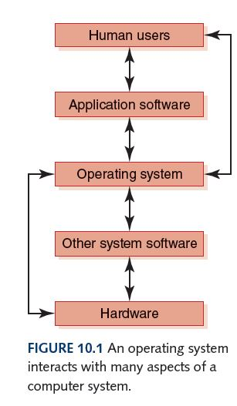
Roles of an Operating System
What operating
systems have
you used?
5
Notes:
5

Slide 6
Roles of an Operating System
Booting
Hardware is wired to initially load a small set of system instructions stored in ROM
These instructions load a larger set of instructions from hard disk
Dual boot – Multiboot
6
Notes:
6

Slide 7
Roles of an Operating System
The various roles of an operating system generally revolve around the idea of “sharing nicely”
An operating system manages resources, and these resources are often shared in one way or another, among programs that want to use them
7
Notes:
7

Slide 8
Resource Management
Multiprogramming
The technique of keeping multiple programs that compete for access to the CPU in main memory at the same time so that they can execute
Memory management
The process of keeping track of what programs are in memory and where in memory they reside
8
Notes:
8

Slide 9
Resource Management
Process
A program in execution
Process management
The act of carefully tracking the progress of a process and all of its intermediate states
CPU scheduling
Determining which process in memory is executed by the CPU at any given point
9
Notes:
9

Slide 10
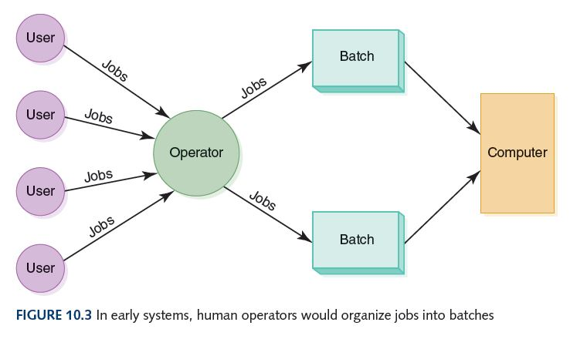
Batch Processing
The first operating system was a human operator, who organized various jobs from multiple users into batches of jobs that needed the same resources
10
Notes:
10

Slide 11
Realtime and Timesharing
Real-time System
A system in which response time is crucial given the nature of the application
Timesharing system
A system that allows multiple users to interact with a computer at the same time
11
Notes:
11

Slide 12
Memory Management
Operating systems must employ techniques to
Track where and how a program resides in memory
Convert logical addresses into actual addresses
Logical address
Reference to a stored value relative to the program making the reference
Physical address
Actual address in main memory
12
Notes:
12

Slide 13
Partition Memory Management
Non-Contagious MM: process is divided into multiple smaller blocks, and these blocks can be placed in different (non-adjacent) areas of memory.
Contagious Partition: In contiguous memory allocation, each process is assigned a single continuous block of memory.
There are two schemes for dividing up memory for programs:
Fixed partitions Main memory is divided into a fixed number of partitions into which programs can be loaded
Dynamic partitions Partitions are created as needed to fit the programs waiting to be loaded
13
Notes:
13

Slide 14
Partition Selection Algorithms
Which partition should we allocate to a new program?
First fit Allocate program to the first partition big enough to hold it
Best fit Allocated program to the smallest partition big enough to hold it
Worst fit Allocate program to the largest partition big enough to hold it
14
Notes:
14

Slide 15
Partition Selection Algorithms
A: 1000
B: 700
C: 750
D: 1500
E: 300
F: 350
Requests come in for blocks of
the following sizes:
1000, 25, 780, 1600, and 325
What block will be assigned
to each request if the
first-fit algorithm is used?
best-fit algorithm is used?
worst-fit algorithm is used?
(Treat each request as an
independent event)
15
Notes:
15

Slide 16
Process Management
Process management
The act of managing the use of the CPU by individual processes
Recall that a process is a program in execution
What stages does a process go through?
16
Notes:
16

Slide 17
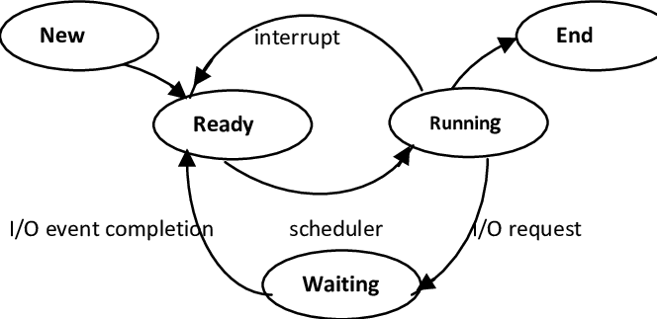
Process Management
What can
cause a
process to
move to
the
Waiting
state?

Slide 18
Process Management
Process control block (PCB)
A data structure used by the OS to manage information about a process, including
current value of the program counter
values of all CPU registers for the process
base and bound register values accounting information
Each state is represented by a list of PCBs, one for each process in that state
18
Notes:
18

Slide 19
CPU Scheduling
CPU Scheduling
The act of determining which process in the ready state should be moved to the running state
Many processes may be in the ready state
Only one process can be in the running state, making progress at any one time
Which one gets to move from ready to running?
19
Notes:
19

Slide 20
CPU Scheduling
Nonpreemptive scheduling
The currently executing process gives up the CPU voluntarily
Preemptive scheduling
The operating system decides to favor another process, preempting the currently executing process
20
Notes:
20

Slide 21
CPU Scheduling
Arrival time
Arrival time is the time when a process enters into the ready state and is ready for its execution.
Response time
Response time is the time taken to start responding to the request. A scheduler must aim to minimize response time for interactive users.
Burst time
Burst time is the total time taken by the process for its execution on the CPU.
21
Notes:
21

Slide 22
CPU Scheduling
Waiting time: Waiting time is the total time spent by the process in the ready state waiting for CPU.
Waiting time = Turnaround time - Burst time
Turnaround time: The amount of time between when a process arrives in the ready state the first time and when it exits the running state for the last time (the total time spent between starting the process and ending the process).
Turnaround time = Burst time + Waiting time

Slide 23
CPU Scheduling Algorithms
First-Come, First-Served
Processes are moved to the CPU in the order in which they arrive in the running state
Shortest Job Next
Process with shortest estimated running time in the ready state is moved into the running state first
Round Robin
Each process runs for a specified time slice and moves from the running state to the ready state to await its next turn if not finished
23
Notes:
23

Slide 24
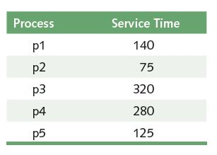
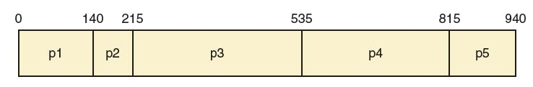
First-Come, First-Served
What is the
average turn-
around time?
24
Notes:
24

Slide 25
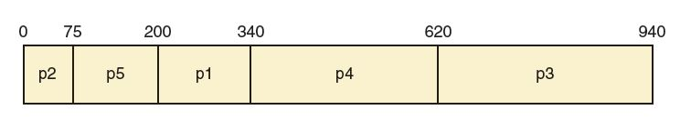
Shortest Job Next
What is the
average turn-
around time?
25
Notes:
25

Slide 26
Round Robin
Every process is treated the same!
Time slice (quantum)
The amount of time each process receives before being preempted and returned to the ready state to allow another process its turn
26
Notes:
26

Slide 27
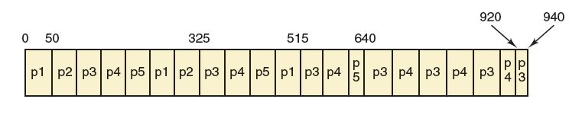
Round Robin
Suppose the time slice is 50
What is the average
turnaround time?
27
Notes:
27

Slide 28
CPU Scheduling Algorithms
Are these scheduling algorithms preemptive or non-preemptive? Explain
First-Come, First-Served?
Shortest Job Next?
Round Robin?
28
Notes:
28

Slide 29
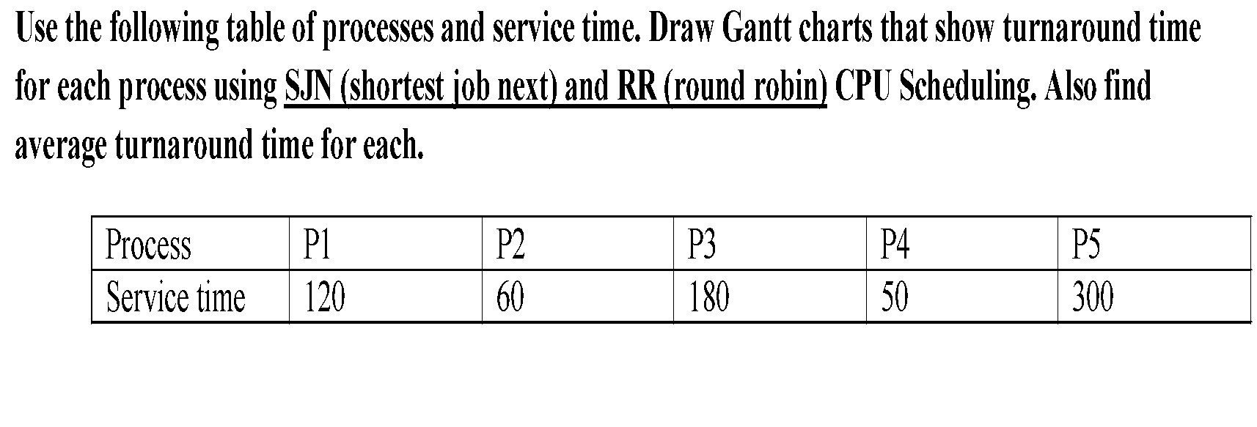

Activity 1:
29

Slide 30
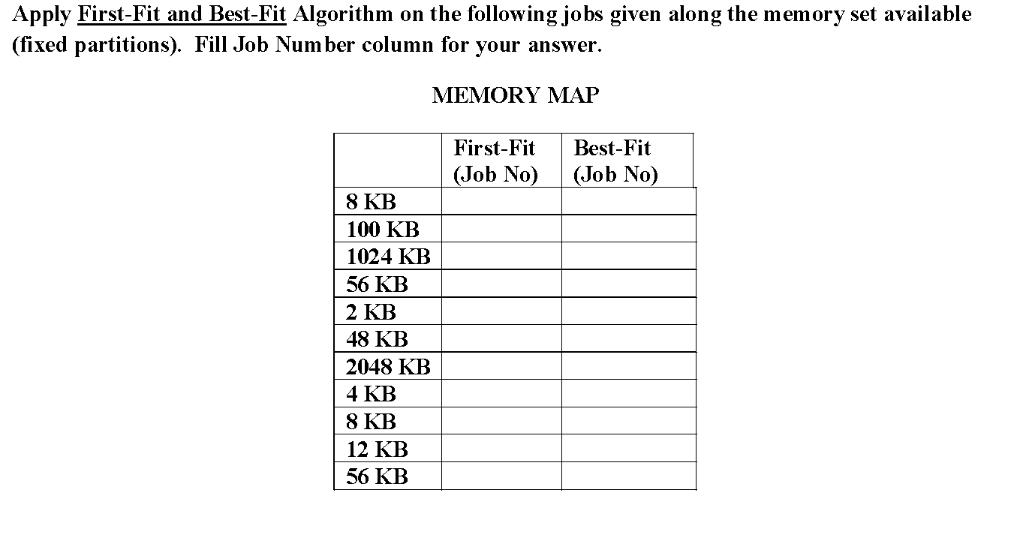
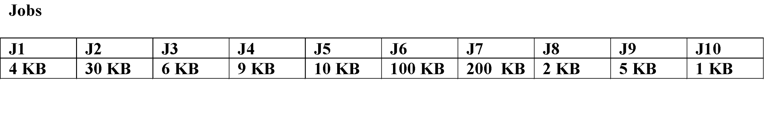
Activity 2:
 | First-Fit (Job No) | Best-Fit (Job No)
8 KB | J1 = 4KB | J3 = 6KB
100 KB | J2 = 30KB | J6 = 100KB
1024 KB | J3 = 6KB | J7 = 7
56 KB | J4 = 9KB | J5 = 10KB
2 KB | J8 = 2KB | J8=2KB
48 KB | J5 = 10KB | J2 = 30KB
2048 KB | J6 = 100KB
4 KB | J10 = 1KB | J1 = 4KB
8 KB | J9 = 5KB | J9 = 5KB
12 KB |  | J4 = 9KB
56 KB |  | J10 = 1KB
30

Slide 31
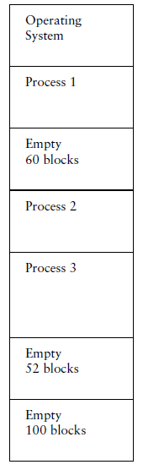
Activity 3:
If the partitions are fixed and a new job arrives
requiring 52 blocks of main memory, show memory
after using each of the following partition selection
approaches:
a. first fit
b. best fit
c. worst fit
31

